Slide 1
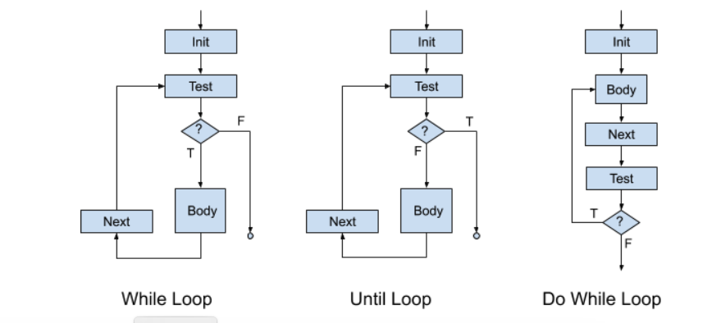
Control Flow Graph
A graphic representation of the representation between basic blocks
A basic block:
a list of instructions with
a single entry point (starting point)
a single exit point (last instruction)
Such representations model the behavior of our code
Recall the while loop, and other control structures
What about subroutines calls (subroutine: general term for … methods, functions, procedures, etc.)

Slide 2
Call Graph
a control flow graph depicting the relationships between subroutines
Call Graph for the "Hello World" program
main
print
print
println
class HelloWorld
{
public static void main(String args[])
{
System.out.print("Hello ");
System.out.print("World"); System.out.println("");
}
}
call:
return:

Slide 3
Call Graph II
main
public static void A(void) {
int x = scan.nextInt();
C();
}
public static void B(void) {
C();
D();
}
public static void C(void) {
;
}
public static void D(void) {
;
}
public static void main(String args[])
{
A();
B();
}
}
A
B
D
C
leaf nodes

Slide 4
Call Graph with a Loop (Recursion)
main
public static void A(void) {
int x = scan.nextInt();
C();
}
public static void B(void) {
C();
D();
}
public static void C(void) {
A();
}
public static void D(void) {
;
}
public static void main(String args[])
{
A();
B();
}
}
A
B
D
C
leaf node

Slide 5
Dynamic Call Graph (Runtime)
main
public static void A(void) {
int x = scan.nextInt();
C();
x ++;
}
public static void B(void) {
C();
D();
}
public static void C(void) {
A();
}
public static void D(void) {
;
}
public static void main(String args[])
{
A();
B();
}
}
x = 5;
x = 6;
A
C
x = 8; x = 9;
A
C

Slide 6
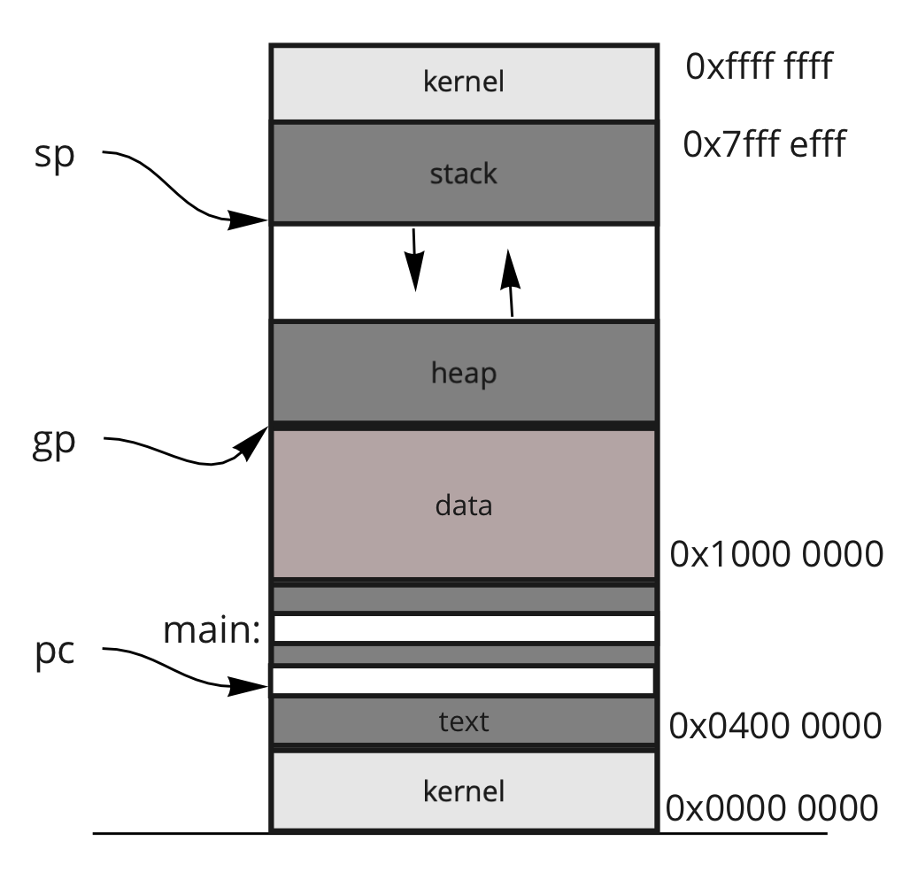
Frames
current address saved in a register
well-known addresses
args
locals
main
temps
args
locals
x = 5;
A
temps
args
locals
C
temps
fp:
args
locals
x = 8;
A
temps
sp:
args
locals
C
temps

Slide 7
Three Address Code (TAC)
Examples:
a = y + x
a = y
a = x + 2
b = d * 2 + y
t0 = d * 2
t1 = t0 + y
b = t1
A generic assembly language in which all instructions have at most three addresses
An address references either
a register location
a memory location
Immediate values are stored in a location within memory
Assumption: the assembly language is for a register-based machine, with an infinite number of registers.

Slide 8
Basic Blocks
label:
x = 3;
z = 5;
y = 3; goto label2
A number of instructions in which there is
a single entry point (via a label), and
a single exit point (via a goto)
All programs can be broken down into a set of basic blocks
A control flow graph determines which a basic block is executed.
Standard control flow graphs
if-then-else and all other variants (e.g., switch)
while, do-while and all other variants
for loop and all other variants
call-return
label2:

Slide 9
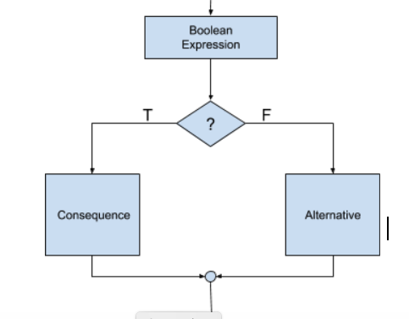
Code Flow: If-then-else
if ( a == b ) {
x = 3;
z = 5;
y = 3;
} else {
null ;
}
B1: a == b
if true goto C1 ;
goto A1
C1:
x = 3
z = 5
y = 3
goto N1
A1:
goto N1
N1:
B1:
a == b
C1:
x= 3;
z= 5;
y =3 ;
A1:
null ;
N1:

Slide 10
Control Flow: Loops
for ( i = 0; i < 10 ; i++ ) {
a = x * 2
}
x = 5;
while ( x < 10 ) { a = x * 2;
x ++;
}
x = 5;
until ( x >= 64 ) { a = x * 2;
x ++;
}
x = 5;
{
a = x * 2;
x ++;
} while ( x < 10)

